Slide 1

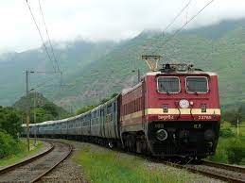
‘Development Of Program
For Warranty Management System
For Coach Safety Components’
Project Report
Prepared by | Submitted to
Sarah Effendi & Ritesh Kumar B.Tech 3rd Year CSE Lucknow University | Shri Anurag Mishra Dy. CME C&W Workshop,AMV,LKO

Slide 2
Abstract
Our project Warranty Management system includes storing the details of safety components into the system. Our software has the facility to search for any detail of the component just by its unique PL Number. It includes a search facility to know the current status of the component. User can search for the warranty of the component using the ID. The Warranty Management System can be used by entering username and password. It is accessible either by an administrator or the person who has the access of the login details. Only they can add data into the database. The data can be retrieved easily. The interface is very user-friendly. The data are well protected for personal use and makes the data processing very fast.

Slide 3
Content
S. No | Description | Page No
1 | Introduction | 1-2
2 | Objective | 3
3 | Project Report Layout | 4
4 | Technologies Used | 5
5 | Innovativeness and Usefulness | 6-7
6 | Data Flow Diagram | 8
7 | Code for admin.py/apps.py | 9
8 | Code for models.py | 10
9 | Code for urls.py | 11
10 | Code for views.py | 12-14
11 | Code for base.html | 15-17
12 | Code for home.html | 18
13 | Code for inventory.html | 19
14 | Code for search.html | 20-21
15 | Code for signin.html | 22-23
16 | Code for signup.html | 24-26
17 | Code for additem.html | 27-28
18 | Snapshots of The directory | 29
19 | Snapshots of The software | 30-32
20 | Conclusion | 33

Slide 4
Introduction
A warranty management system (or warranty system) is the process by which you track the warranty of your goods throughout your entire supply chain.
It governs how you approach warranty management for your business
Our project Warranty Management system includes storing the details of safety components into the system. Our software has the facility to search for any detail of the component just by its unique PL Number. It includes a search facility to know the current status of the component. User can search for the warranty of the component using the ID. The Warranty Management System can be used by entering username and password. It is accessible either by an administrator or the person who has the access of the login details. Only they can add data into the database.

Slide 5
All of this information must be managed in an efficient and cost wise fashion so that an institution's resources may be effectively utilized HMS will automate the management of the hospital making it more efficient and error free. It aims at standardizing data, consolidating data ensuring data integrity and reducing inconsistencies.
Thus, the designed project on warranty management system will provide an accurate data of the warranty of the components. These data can be retrieved in minimum time with highest accuracy. By using this software, a lot of time can be saved and record keeping files can be minimized. This software will also help in showing how much warranty is left in quick, accurate and efficient manner.

Slide 6

Objective
The primary objective of this project is to create a comprehensive database which enlists the details, warranty, serial numbers amongst other things of the parts which are used in manufacturing trains. Additionally, this project aims at summarizing all of the aforementioned details and compile it all into a single list which will generate information regarding the residue of warranty of the concerned product.

Slide 7
Project Report Layout
⮚Admin Login Module - This module record only user id and password. This module is only used by administrator and people with credentials .
⮚ Search Module – One can search for the components just by its PL No.
⮚ Home – For further information, one can go to the official website of C&W Workshop from Home. Also, it contains all the further information of the program.
⮚ Inventory – It contains the database i.e data of all the safety components.
⮚ Add Items – One can add details of the item through “add items” section.

Slide 8
Technologies Used
Well a technology stack is the complete set of technologies required for the completion of a project.
This project will be using the following technology stack:
Minimum Hardware Required:-
Processor –Intel Dual Core i2.
(10M Cache, 2.6 GHz).
RAM - 2.0GB.
ROM- 1 GB ( For installing).
Minimum Software Required:-
Operating system:- window 8.
Web Browser:- Google Chrome, Microsoft Edge.
Window’s software:- Windows Terminal, PowerShell.
Language used :- Python3.10, Django Web framework, Bootstrap.
Database:- SQLlite.

Slide 9
Innovativeness And Usefulness
In a large company, warranty management is almost essential in achieving effective organisation of the business. It can also improve the customer’s confidence in your products and services which, in turn, will help to increase retention and potentially generate new leads. Investing in a warranty management system will not only include both the management of warranty and post-warranty support, but it’ll also eliminate the risk of fraud and provide opportunities to up-sell. All manual tasks such as registering, processing and settling claims, issuing returns and replacements and checking inventory can be far more efficient with a management system in place.

Slide 10
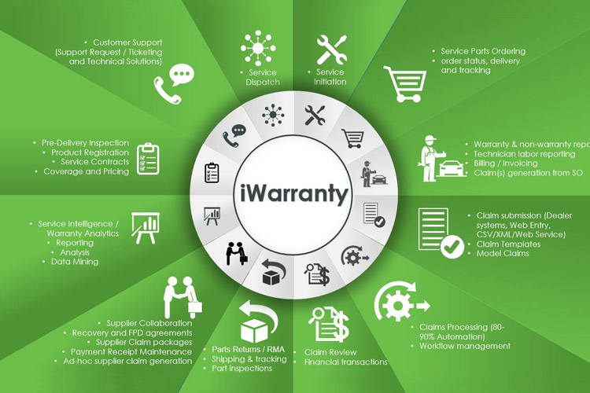
Here are some of the ways that warranty management software can transform your current warranty management processes:
Improve visibility of the entire warranty and case management process
Analyze the causes of product failures and make improvements
Enhance productivity with a seamless, automated workflow Reduce costs by eliminated manual processes

Slide 11
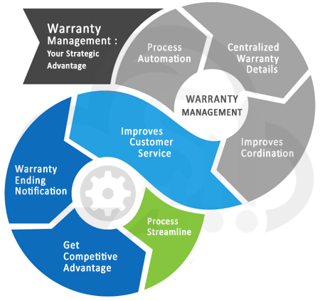
Data Flow Diagram
The data flow diagram is a graphical representation of the flow of the data through an information system. Data flow diagram is used by system analysis to design information processing system but also as a way to model whole organization. The main merit of DFD is that it can provide an overview of what data a system would process, what information of data are done, which data are stored and which data is used and where the result is showed.

Slide 12
Code for Admin.py
-
from django.contrib import admin
from warranty.models import Additem
# Register your models here.
admin.site.register(Additem)
Code for Apps.py
from django.apps import AppConfig
class WarrantyConfig(AppConfig):
name = 'warranty'

Slide 13
Code for Models.py
from pyexpat import model
from django.db import models
# Create your models here.
class Additem(models.Model):
plno=models.CharField(max_length=120)
relatedplno=models.CharField(max_length=120)
unifiedplno=models.CharField(max_length=120)
desc=models.CharField(max_length=500)
aac=models.CharField(max_length=120)
specno=models.CharField(max_length=500)
gw=models.CharField(max_length=500)
date=models.DateField()
#to change the name field of the additem's database
def __str__(self):
return self.plno

Slide 14
Code For urls.py
from django.contrib import admin
from django.urls import path
from warranty import views
urlpatterns = [
path('',views.index,name='signin'),
path('inventory',views.inventory,name='inventory'),
path('home',views.home,name='home'),
path('additem',views.additem,name='additem'),
path('signin',views.signin,name='signin'),
path('signup',views.signup,name='signup'),
path('signout',views.signout,name='signout'),
path('search',views.search,name="search")
]

Slide 15
Code For Views.py
import dataclasses
from imaplib import _Authenticator
from multiprocessing import context
from telnetlib import LOGOUT
from django.shortcuts import redirect, render,HttpResponse
from django.contrib.auth.models import User
from django.contrib import messages
from django.contrib.auth import authenticate,login, logout
from datetime import date, datetime
from warranty.models import Additem
from django.db.models import Q
# Create your views here.
def index(request):
return render(request,'signin.html')
def home(request):
return render(request,'home.html')
def search(request):
if 'q' in request.GET:
q = request.GET['q']
#data = Additem.objects.filter(plno__icontains=q)
multiple_q = Q(Q(plno__icontains=q) | Q(relatedplno__icontains=q) | Q(unifiedplno__icontains=q) )
data = Additem.objects.filter(multiple_q)
messages.success(request, 'Your Search Data is.')
else:
data = Additem.objects.all()
context = {
'data' : data
}
return render(request,'search.html',context)
def inventory(request):
invent = Additem.objects.all()
return render(request, 'inventory.html',{"invent":invent })

Slide 16
def additem(request):
additem = Additem.objects.all() # delete
if request.method == "POST":
plno = request.POST.get('plno')
relatedplno = request.POST.get('relatedplno')
unifiedplno = request.POST.get('unifiedplno')
desc = request.POST.get('desc')
aac = request.POST.get('aac')
specno = request.POST.get('specno')
gw = request.POST.get('gw')
#object additem
additem = Additem(plno=plno, relatedplno=relatedplno, unifiedplno=unifiedplno, desc=desc, aac=aac, specno=specno,gw=gw, date=datetime.today())
additem.save()
messages.success(request, 'items details has been successfully updated.')
return render(request, 'additem.html')
def signin(request):
if request.method == 'POST':
username = request.POST['username']
password = request.POST['password']
user = authenticate(username=username,password=password)
if user is not None:
login(request, user)
fname = user.first_name
messages.success(request,"login Successfully.")
return render(request,"home.html",{'fname' : fname} )

Slide 17
else:
messages.error(request,"Wrong Credentials!!")
return redirect('signin')
return render(request, 'signin.html')
def signup(request):
if request.method=="POST":
fname= request.POST['fname']
lname= request.POST['lname']
username= request.POST['username']
email= request.POST['email']
password= request.POST['password']
confirmpassword= request.POST['confirmpassword']
railwayuser = User.objects.create_user(username,email,password)
railwayuser.first_name = fname
railwayuser.last_name = lname
railwayuser.save()
messages.success(request,"Your Account has been Successfully Created.")
return redirect('signin')
return render(request, 'signup.html')
def signout(request):
logout(request)
messages.success(request," Logout Successfully.")
return redirect('signin')

Slide 18
Code For base.html
<!doctype html>
<html lang="en">
<head>
<!-- Required meta tags -->
<meta charset="utf-8">
<meta name="viewport" content="width=device-width, initial-scale=1">
<!-- Bootstrap CSS -->
<link href="https://cdn.jsdelivr.net/npm/bootstrap@5.1.3/dist/css/bootstrap.min.css" rel="stylesheet" integrity="sha384-1BmE4kWBq78iYhFldvKuhfTAU6auU8tT94WrHftjDbrCEXSU1oBoqyl2QvZ6jIW3" crossorigin="anonymous">
<title> {% block title %}
{% endblock title %}
| Warranty Management System</title>
{% block head %} {% endblock head %}
</head>
<body>
<nav class="navbar navbar-expand-lg navbar-dark bg-dark">
<div class="container-fluid">
<a class="navbar-brand" href="{% url 'home' %}">Warranty Management System</a>
<button class="navbar-toggler" type="button" data-bs-toggle="collapse" data-bs-target="#navbarSupportedContent" aria-controls="navbarSupportedContent" aria-expanded="false"

Slide 19
aria-label="Toggle navigation">
<span class="navbar-toggler-icon"></span>
</button>
<div class="collapse navbar-collapse" id="navbarSupportedContent">
<ul class="navbar-nav me-auto mb-2 mb-lg-0">
<li class="nav-item">
<a class="nav-link active" aria-current="page" href="{% url 'home' %}">Home</a>
</li>
<li class="nav-item">
<a class="nav-link" href="{% url 'inventory' %}">Inventory</a>
</li>
<li class="nav-item">
<a class="nav-link" href="{% url 'additem' %}">Add Items</a>
</li>
<li class="nav-item">
<a class="nav-link" href="{% url 'search' %}">Search</a>
</li>
{% if user.is_authenticated %}
<li class="nav-item">
<a class="nav-link" href="{% url 'signout' %}">Logout</a>
{% else %}
<li class="nav-item">
<a class="nav-link" href="{% url 'signin' %}">signin</a>
<li class="nav-item">
<a class="nav-link" href="{% url 'signup' %}">signup</a>
{% endif %}
</li>

Slide 20
</ul>
</div>
</div>
</nav>
{% if messages %}
{% for message in messages %}
<div class="alert alert-{{ message.tags }} alert-dismissible fade show" role="alert">
{{ message }}
<button type="button" class="btn-close" data-bs-dismiss="alert" aria-label="Close"></button>
</div>
{% endfor %}
{% endif %}
{% block body %}{% endblock body %}
<!-- Optional JavaScript; choose one of the two! -->
<!-- Option 1: Bootstrap Bundle with Popper -->
<script src="https://cdn.jsdelivr.net/npm/bootstrap@5.1.3/dist/js/bootstrap.bundle.min.js" integrity="sha384-ka7Sk0Gln4gmtz2MlQnikT1wXgYsOg+OMhuP+IlRH9sENBO0LRn5q+8nbTov4+1p" crossorigin="anonymous"></script>
<!-- Option 2: Separate Popper and Bootstrap JS -->
<!--
<script src="https://cdn.jsdelivr.net/npm/@popperjs/core@2.10.2/dist/umd/popper.min.js" integrity="sha384-7+zCNj/IqJ95wo16oMtfsKbZ9ccEh31eOz1HGyDuCQ6wgnyJNSYdrPa03rtR1zdB" crossorigin="anonymous"></script>
<script src="https://cdn.jsdelivr.net/npm/bootstrap@5.1.3/dist/js/bootstrap.min.js" integrity="sha384-QJHtvGhmr9XOIpI6YVutG+2QOK9T+ZnN4kzFN1RtK3zEFEIsxhlmWl5/YESvpZ13" crossorigin="anonymous"></script>
-->
</body>
</html>

Slide 21
Code For home.html
{% extends 'base.html' %}
{% load static %}
{% block title %}HOME{% endblock title %}
{% block head %}
<link rel="stylesheet" href="{% static 'home.css' %}">
{% endblock head %}
{% block body %}
<header>
<div class="text">
<h1>Northern Railway, C&W Workshop</h1>
<p>Warranty Management System</p>
<a href="http://cwmnramvlko.in/" target="_blank">Click for more information.</a>
</div>
</header>
{% endblock body %}

Slide 22
Code For inventory.html
{% extends 'base.html' %}
{% load static %} {% block title %}Inventory{% endblock title %} {% block head %}
<link rel="stylesheet" href="{% static 'inventory.css' %}">
{% endblock head %} {% block body %} <h1>Item's Detail</h1>
<hr>
<table>
<tr id="header">
<th>PL NO:</th>
<th>RELATED PL NO:</th>
<th>UNIFIED PL NO:</th>
<th>DESCRIPTION:</th>
<th>AAC:</th>
<th>SPECIFICATION NO:</th>
<th>GUARANTEE/WARRANTY: </th>
<th>CREATED DATE: </th>
</tr>
{% for Inventory in invent %}
<tr>
<td>{{Inventory.plno}} </td>
<td>{{Inventory.relatedplno}} </td>
<td>{{Inventory.unifiedplno}} </td>
<td> {{Inventory.desc}} </td>
<td>{{Inventory.aac}} </td>
<td>{{Inventory.specno}} </td>
<td>{{Inventory.gw}} </td>
<td>{{Inventory.date}} </td> </tr>
{% endfor %}
</table> {% endblock body %}

Slide 23
Code For search.html
{% extends 'base.html' %}
{% load static %}
{% block title %}Inventory{% endblock title %}
{% block head %}
<link rel="stylesheet" href="{% static 'search.css' %}">
{% endblock head %}
{% block body %}
<h1>Item's Detail</h1>
<div class="container">
<form class="d-flex">
<input class="form-control me-2" name = "q" type="search" placeholder="Search" aria-label="Search">
<button class="btn btn-outline-success" type="submit">Search</button>
</form>
</div>
<table>
<tr id="header">
<th>PL NO:</th>
<th>RELATED PL NO:</th>
<th>UNIFIED PL NO:</th>
<th>DESCRIPTION:</th>
<th>AAC:</th>
<th>SPECIFICATION NO:</th>
<th>GUARANTEE/WARRANTY: </th>
<th>CREATED DATE: </th>
</tr>
{% for data in data %}

Slide 24
<tr>
<td>{{data.plno}} </td>
<td>{{data.relatedplno}} </td>
<td>{{data.unifiedplno}} </td>
<td> {{data.desc}} </td>
<td>{{data.aac}} </td>
<td>{{data.specno}} </td>
<td>{{data.gw}} </td>
<td>{{data.date}} </td>
</tr>
{% endfor %}
</table>
{% endblock body %}

Slide 25
Code For signin.html
{% load static %}
<!doctype html>
<html lang="en">
<head>
<!-- Required meta tags -->
<meta charset="utf-8">
<meta name="viewport" content="width=device-width, initial-scale=1">
<!-- Bootstrap CSS -->
<link href="https://cdn.jsdelivr.net/npm/bootstrap@5.1.3/dist/css/bootstrap.min.css" rel="stylesheet" integrity="sha384-1BmE4kWBq78iYhFldvKuhfTAU6auU8tT94WrHftjDbrCEXSU1oBoqyl2QvZ6jIW3" crossorigin="anonymous">
<title>Warranty Management System</title>
<link rel="stylesheet" href="{% static 'signin.css' %}">
</head>
<body>
<nav class="navbar navbar-expand-lg navbar-dark bg-dark">
<div class="container-fluid">
<a class="navbar-brand" href="{% url 'signin' %}">Warranty Management System</a>
<button class="navbar-toggler" type="button" data-bs-toggle="collapse" data-bs-target="#navbarSupportedContent" aria-controls="navbarSupportedContent" aria-expanded="false" aria-label="Toggle navigation">
<span class="navbar-toggler-icon"></span>
</button>
<div class="collapse navbar-collapse" id="navbarSupportedContent">
<ul class="navbar-nav me-auto mb-2 mb-lg-0">
{% if user.is_authenticated %}

Slide 26
{% else %}
<li class="nav-item">
<a class="nav-link" href="{% url 'signup' %}">SIGN UP</a>
{% endif %}
</div>
</div>
</nav>
{% if messages %}
{% for message in messages %}
<div class="alert alert-{{ message.tags }} alert-dismissible fade show" role="alert">
{{ message }}
<button type="button" class="btn-close" data-bs-dismiss="alert" aria-label="Close"></button>
</div>
{% endfor %}
{% endif %} <form action="/signin" method="post">
{% csrf_token %}
<div class="wrapper">
<div class="header-text"> ADMIN LOGIN </div>
<input type="text" id="username" name="username" placeholder="Your Username">
<input type="password" id="password" name="password" placeholder="Your Password">
<button> Sign In </button>
</div>
</form>
<script src="https://cdn.jsdelivr.net/npm/bootstrap@5.1.3/dist/js/bootstrap.bundle.min.js" integrity="sha384-ka7Sk0Gln4gmtz2MlQnikT1wXgYsOg+OMhuP+IlRH9sENBO0LRn5q+8nbTov4+1p" crossorigin="anonymous"></script>
-->
</body>
</html>

Slide 27
Code For signup.html
{% load static %}
<!doctype html>
<html lang="en">
<head>
<!-- Required meta tags -->
<meta charset="utf-8">
<meta name="viewport" content="width=device-width, initial-scale=1">
<!-- Bootstrap CSS -->
<link href="https://cdn.jsdelivr.net/npm/bootstrap@5.1.3/dist/css/bootstrap.min.css" rel="stylesheet" integrity="sha384-1BmE4kWBq78iYhFldvKuhfTAU6auU8tT94WrHftjDbrCEXSU1oBoqyl2QvZ6jIW3" crossorigin="anonymous">
<title>Warranty Management System</title>
<link rel="stylesheet" href="{% static 'signup.css' %}">
</head>
<body>
<nav class="navbar navbar-expand-lg navbar-dark bg-dark">
<div class="container-fluid">
<a class="navbar-brand" href="{% url 'home' %}">Warranty Management System</a>
<button class="navbar-toggler" type="button" data-bs-toggle="collapse" data-bs-target="#navbarSupportedContent" aria-controls="navbarSupportedContent" aria-expanded="false" aria-label="Toggle navigation">
<span class="navbar-toggler-icon"></span>
</button>
<div class="collapse navbar-collapse" id="navbarSupportedContent">
<ul class="navbar-nav me-auto mb-2 mb-lg-0">
{% if user.is_authenticated %}
{% else %}

Slide 28
<li class="nav-item">
<a class="nav-link" href="{% url 'signin' %}">LOGIN</a>
{% endif %}
</li>
</ul>
</div>
</div>
</nav>
{% if messages %}
{% for message in messages %}
<div class="alert alert-{{ message.tags }} alert-dismissible fade show" role="alert">
{{ message }}
<button type="button" class="btn-close" data-bs-dismiss="alert" aria-label="Close"></button>
</div>
{% endfor %}
{% endif %}
<form action="/signup" method="post">
{% csrf_token %}
<div class="wrapper">
<div class="header-text"> ADMIN SIGN UP </div>
<input type="text" id="fname" name="fname" placeholder="First Name">
<input type="text" id="lname" name="lname" placeholder="Last Name">
<input type="text" id="username" name="username" placeholder="Your Username">

Slide 29
<input type="email" id="email" name="email" placeholder="E mail">
<input type="password" id="password" name="password"placeholder="Your Password">
<input type="password" id="confirmpassword" name="confirmpassword"placeholder="confirm Your Password">
<button type="submit"> Sign Up </button>
</div>
</form>
<script src="https://cdn.jsdelivr.net/npm/bootstrap@5.1.3/dist/js/bootstrap.bundle.min.js" integrity="sha384-ka7Sk0Gln4gmtz2MlQnikT1wXgYsOg+OMhuP+IlRH9sENBO0LRn5q+8nbTov4+1p" crossorigin="anonymous"></script>
</body>
</html>

Slide 30
Code For additem.html
{% extends 'base.html' %}
{% load static %}
{% block title %}Inventary{% endblock title %}
{% block head %}
<link rel="stylesheet" href="{% static 'additem.css' %}">
{% endblock head %}
{% block body %}
<div class="wrapper">
<div class="registration_form">
<div class="title">
Item details
</div>
<form method="POST" action="/additem">
{% csrf_token %}
<div class="form_wrap">
<div class="input_grp">
<div class="input_wrap">
<label for="plno">PL NO.</label>
<input type="text" id="plno" name="plno">
</div>
<div class="input_wrap">
<label for="realtedplno">Related PL NO.</label>
<input type="text" id="relatedplno" name="relatedplno">

Slide 31
</div>
<div class="input_wrap">
<label for="unifiedplno">Unified PL NO.</label>
<input type="text" id="unifiedplno" name="unifiedplno">
</div>
</div>
<div class="input_wrap">
<label for="desc">Description</label>
<input type="text" id="desc" name="desc">
</div>
<div class="input_wrap">
<label for="aac">AAC</label>
<input type="text" id="aac" name="aac">
</div>
<div class="input_wrap">
<label for="specno">Spec NO.</label>
<input type="text" id="specno" name="specno">
</div>
<div class="input_wrap">
<label for="gw">Guarantee/warranty</label>
<input type="text" id="gw" name="gw">
</div>
<div class="input_wrap">
<input type="submit" value="submit" class="submit_btn">
</div>
</div>
</form>
</div>
</div>
{% endblock body %}

Slide 32
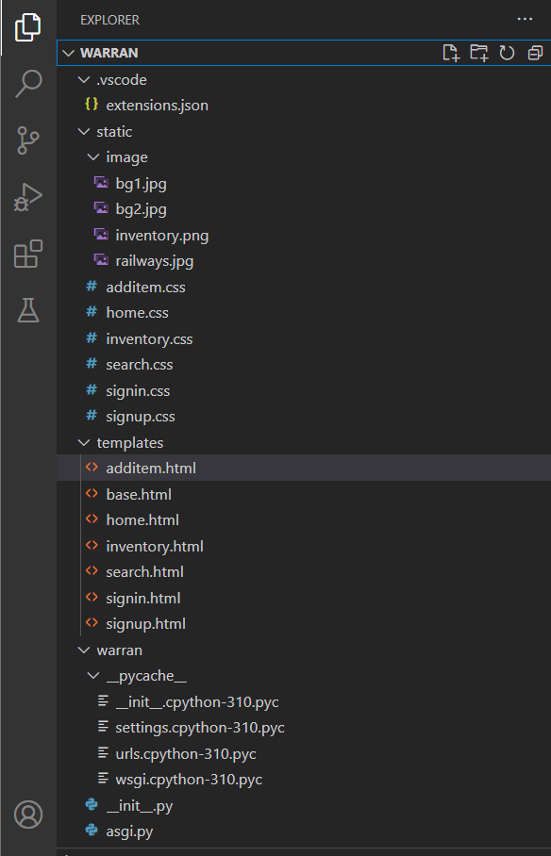
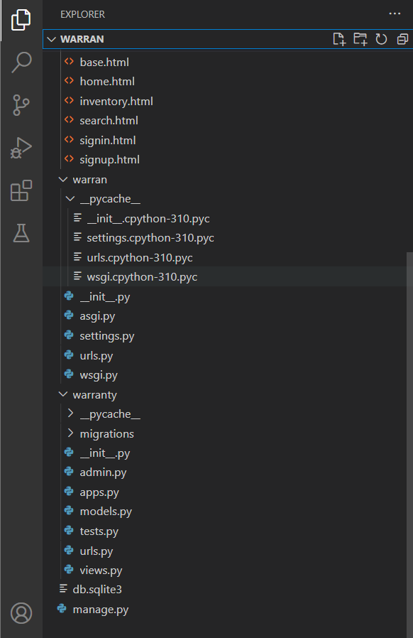
Snapshots of The directory

Slide 33
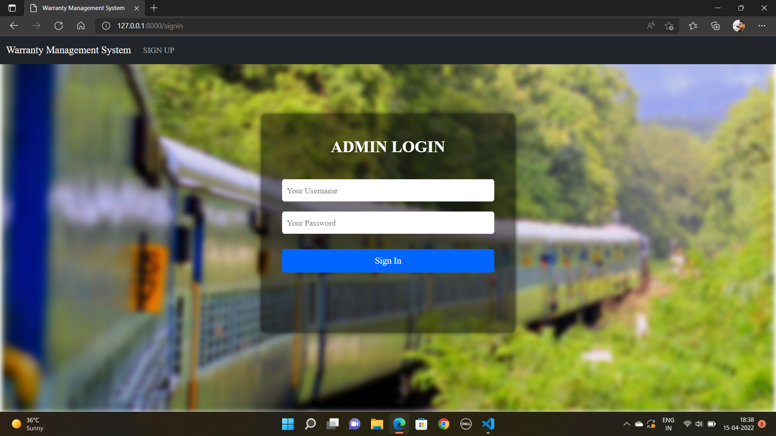
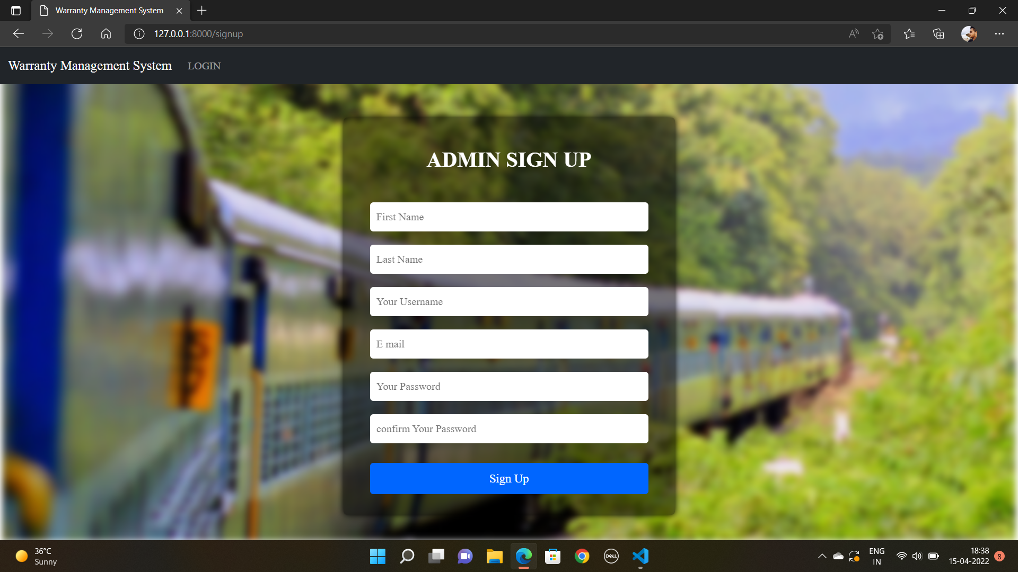
Snapshots Of The Program

Slide 34
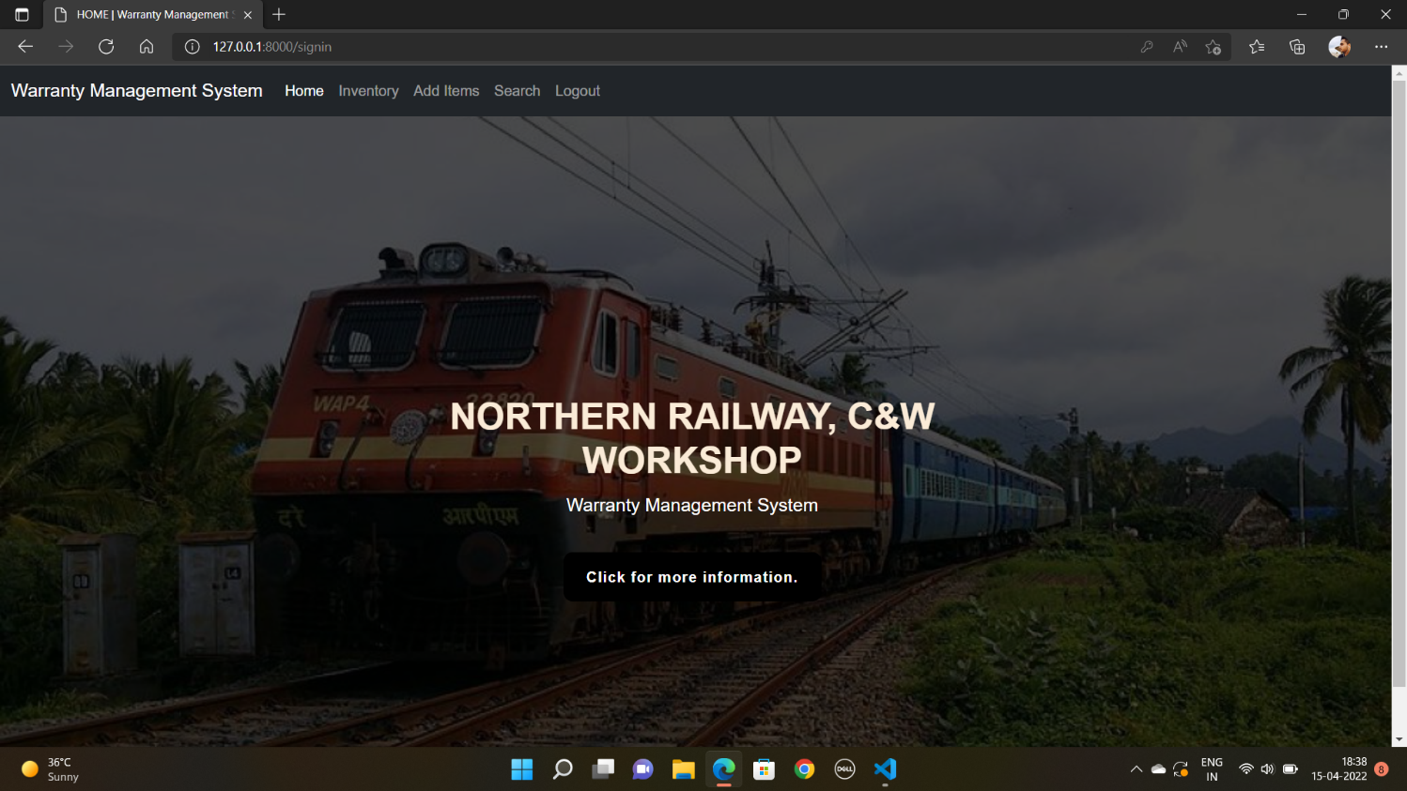
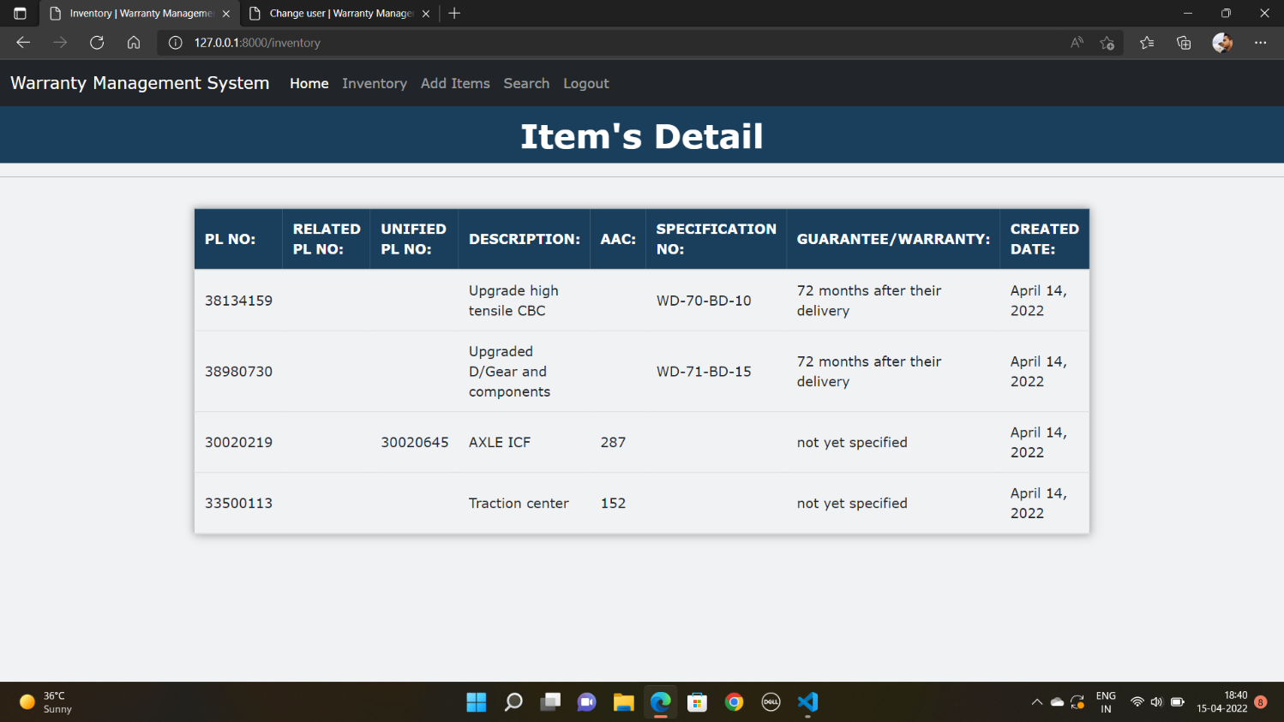

Slide 35
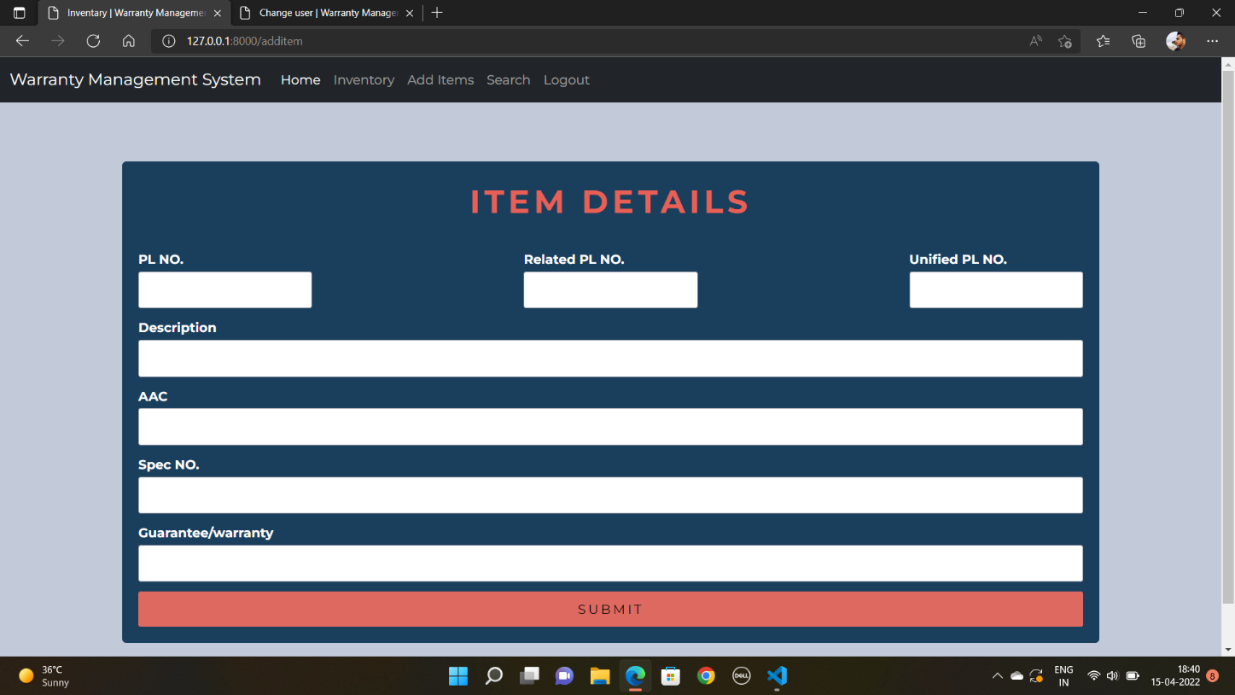
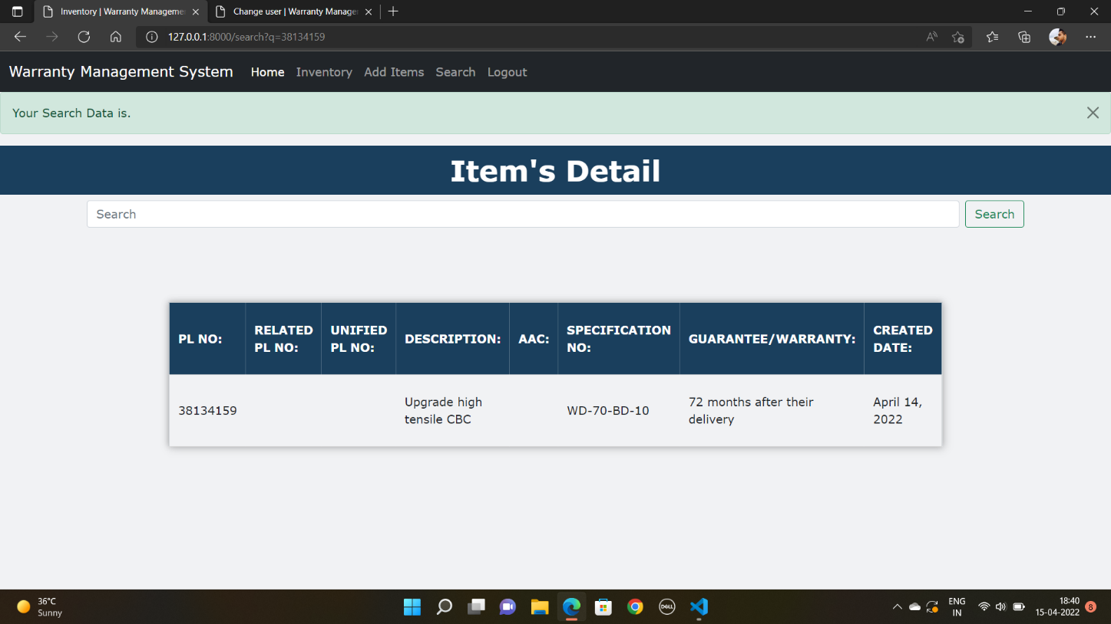

Slide 36

Conclusion
This project has helped us in not only enhancing our technical skills but also in making us to get into the world of Computer Science thoroughly. Various platforms has been used in designing this project.
This program will not only be useful for one organization but also for various other firms who has to deal with large amount of database.

